Slide 1
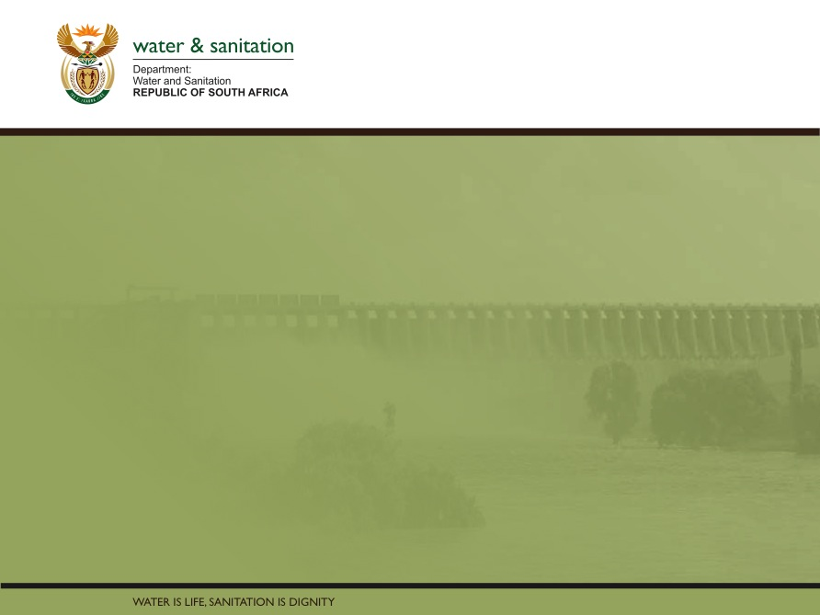
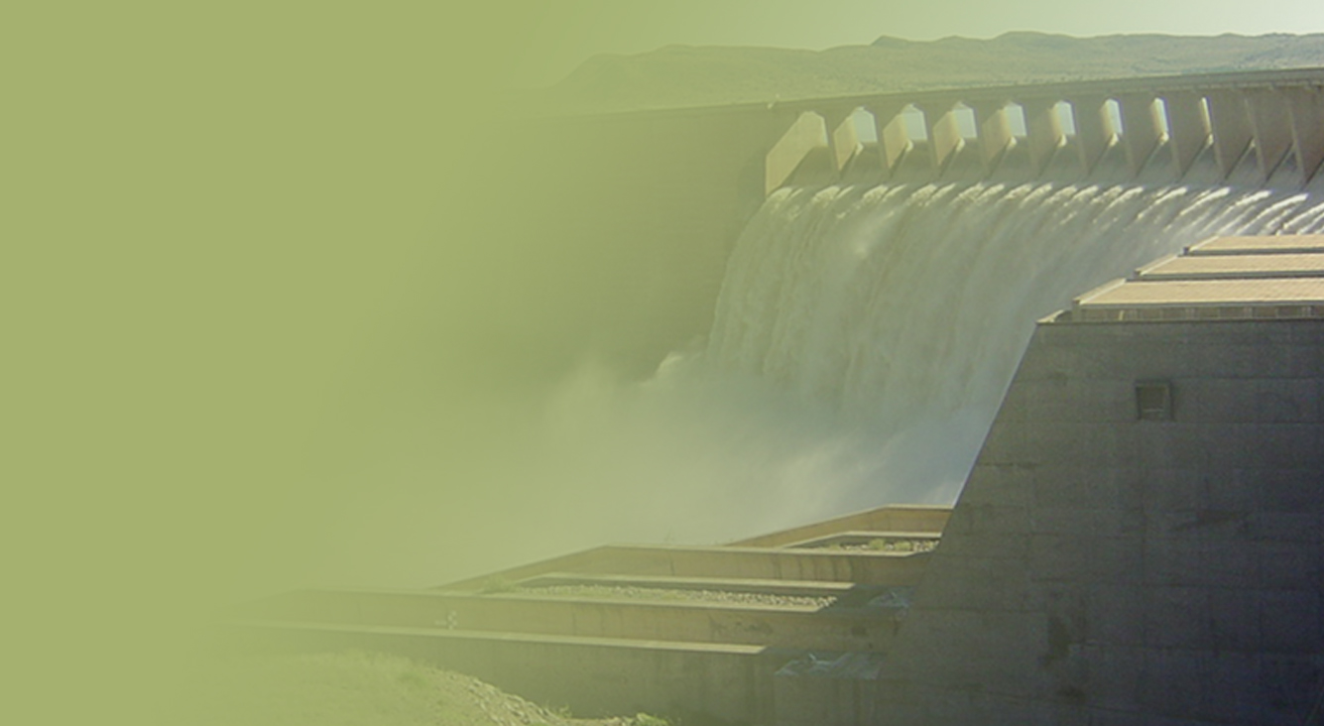
Classification Of Water Resources and Determination of the Comprehensive Reserve and Resource Quality Objectives in the Mvoti To Umzimkulu Water Management Area
DRAFT WETLAND RQOs
Presented by:
Mark Rountree
24 March 2015
PRESENTATION TITLE
Presented by:
Name Surname
Directorate
Date

Slide 2
Wetland RQOs in the Mvoti WMA
BACKGROUND
Wetlands in the Mvoti WMA
There are many thousands of wetlands in the Mvoti WMA (Nel et al. 2011), including two Ramsar wetlands (Ntsikeni wetland & Mngeni sponge).
Activities in and around all wetlands are subject to authorisations under the National Water Act.
The DWS evaluates proposed developments through the WULA system.
RQOs are a set of narrative and/or numerical management objectives defined for water resources. These set the objectives for the desired condition of the resource and can be used to guide the evaluation of WULAs.
Verified baseline information is required to set a RQO.

Slide 3
Wetland RQOs in the Mvoti WMA
BACKGROUND
DWS and Wetlands
The DWS’s National Water Resource Strategy (DWA, 2013) provides for two key aspects related to the management of wetlands, namely to
address proactively, as well as remedially, the loss and degradation of wetlands and
maintain healthy, functional ecosystems.
In addition to the NWRS, the DWS’s National Wetland Position Paper (in prep) has proposed an objective that there be no net loss of wetland ecosystem functions in South Africa.
The draft RQOs for the wetlands of the Mvoti WMA attempt to adhere to the objectives for wetlands proposed by these two national strategy documents.

Slide 4
Wetland RQOs in the Mvoti WMA
APPROACH
Levels of RQOs
Three levels of RQO’s have been identified for wetlands:
Level 3 RQOs for priority wetlands (individual high priority wetlands)
Level 2 RQOs for high priority catchments (average wetland EIS is moderate, high or very high)
Level 1 RQOs for all other wetlands, and potential FEPAs

Slide 5
Wetland RQOs in the Mvoti WMA
APPROACH
Level 1 RQOs for priority individual wetlands
In 2012 each sub-quaternary catchment was assessed to identify large (level 1) FEPA wetlands which were directly dependent on river flows.
These were prioritised in the identification of key hotspots for the selection of river EWR sites
Hotspots used in the IUAs and analysis of scenarios for the WMA
None of the flow scenarios impacts upon wetlands.
However, many impacts upon wetlands are non-flow related

Slide 6
Wetland RQOs in the Mvoti WMA
APPROACH
Level 1 RQOs for priority individual wetlands
Regardless of river flow dependence, other priority wetlands (Ramsar sites, Important Birding Areas and priority Ezemvelo KZN wildlife wetland monitoring sites) were also identified.
Of these, 4 high priority sites (including the two RAMSAR sites) had existing monitoring (EcoStatus) data which allowed for the generation of specific RQOs. The four high priority wetlands in the Mvoti WMA were:
  Ntsikeni wetland (a Ramsar wetland)
  Mgeni sponge (a Ramsar wetland)
  The Mvoti vlei (priority KZN Ezemvelo monitoring site), and
  The Swamp (priority KZN Ezemvelo wetland monitoring site).

Slide 7
Wetland RQOs in the Mvoti WMA
APPROACH
Level 2 RQOs for priority catchments (1)
There are many thousands of wetlands in the Mvoti and it is unrealistic to try to define or monitor specific RQOs for each individual wetland. Moreover, there was no widespread EcoStatus (baseline condition) information of the wetlands.
In 2012 a desktop assessment to estimate the EIS of wetlands per quaternary catchment was undertaken to provide some indication of priority wetland catchments within the WMA.
These desktop data identified priority wetland catchments – those with moderate, high or very high EIS.

Slide 8
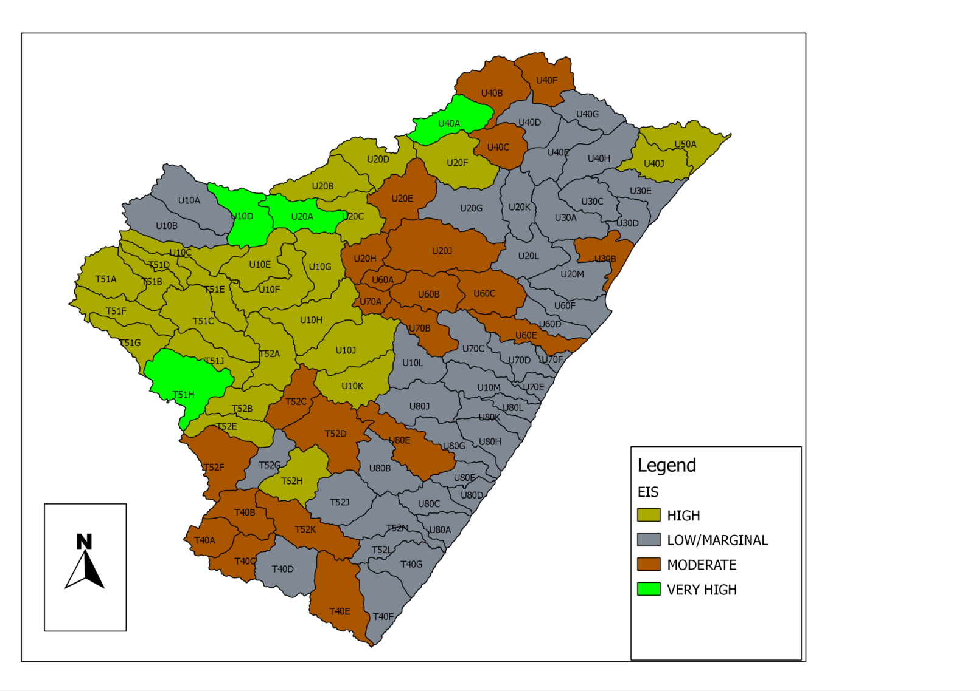
Wetland RQOs in the Mvoti WMA
APPROACH
Level 2 RQOs for priority catchments (2)
These data provide an indication of catchments with important (moderate or higher EIS) wetlands.
Ramsar wetland
Priority Ezemvelo KZN
Wildlife wetland

Slide 9
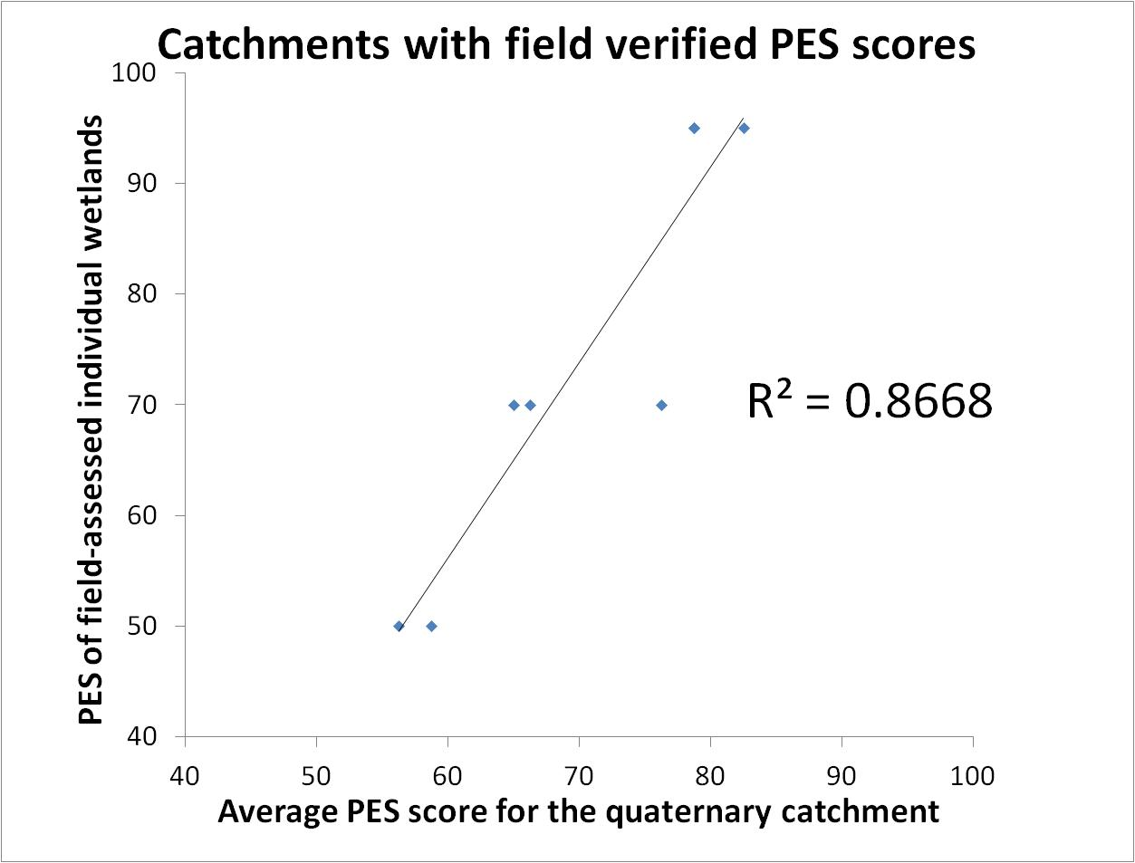
Wetland RQOs in the Mvoti WMA
APPROACH
Level 2 RQOs for priority catchments (3)
For the priority catchments (moderate, high or very high EIS), an average PES category was determined
  A variety of within-wetland and catchment landuse activities and condition scored to estimate PES
  Small sample size of field data (n=8), but good correlation between desktop assessed and field verified scores (R² = 0.866).

Slide 10
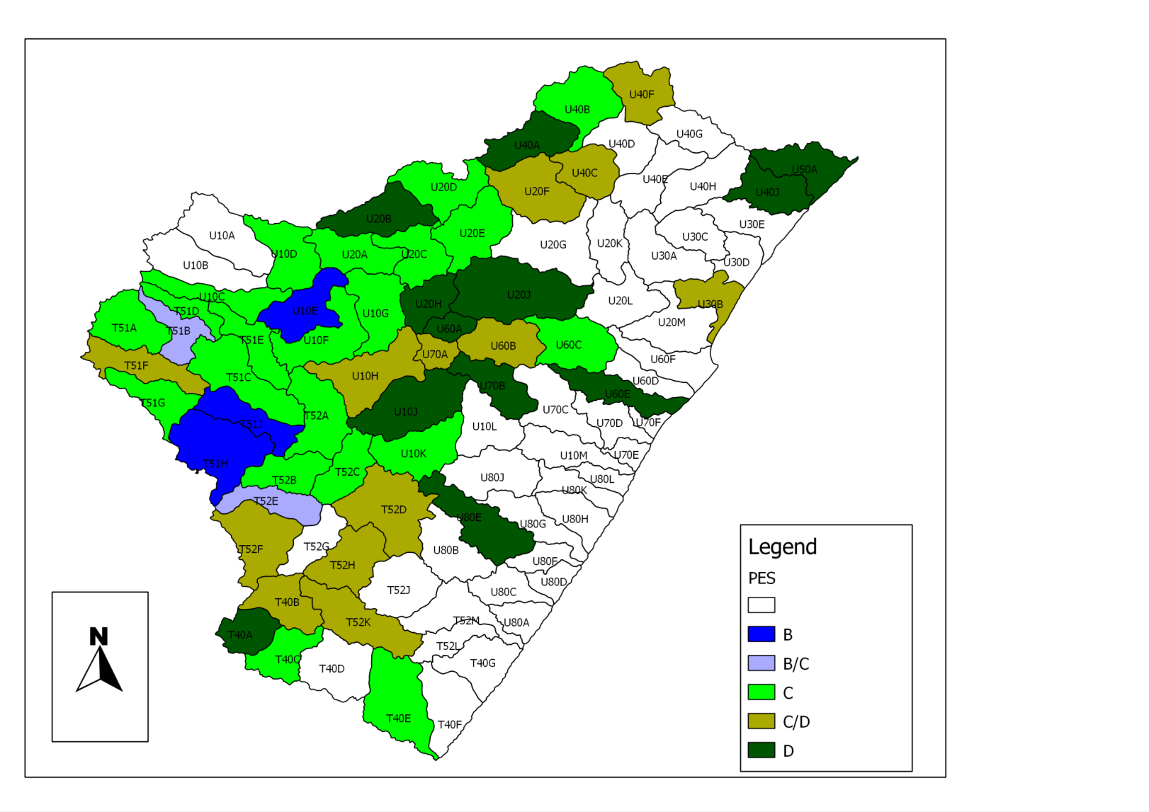
Wetland RQOs in the Mvoti WMA
APPROACH
Level 2 RQOs for priority catchments (4)
Baseline PES for priority catchments (moderate, high or very high EIS)

Slide 11
Wetland RQOs in the Mvoti WMA
APPROACH
Level 3 RQOs for general wetlands and other FEPAs
For all wetlands within the WMA (including non-priority catchments), ecosystem services of wetlands must be maintained (objective of the DWS’s Wetland Position Paper).
Across the WMA, FEPA wetlands (desktop estimates of potential priortity wetlands) are present.
  Level 1 RQOs relating to FEPA wetlands have been set in the event that data (verification) on specific wetlands becomes available in the future.
  These RQOs aim to maintain the TARGET (or achieve, if Target is higher than PES) the EC of the wetland for water quantity, quality, habitat and key biota components.

Slide 12
Wetland RQOs in the Mvoti WMA
LEVEL 3 RQOs
Priority wetland: Mngeni Sponge (RAMSAR)
Mgeni sponge (Ramsar wetland)
IUA and SQ | Component | Sub-component | RQO | Indicator
 |  |  | Numerical
MRU uMnA (U20A-04253 ) | Water availability | Hydrology | PES is a C and must be maintained or improved. | Wetland hydrology score. Detailed assessment of wetland hydrology using a PES tool at 3 - 5 years intervals.
 | Habitat | Geomorphology | PES is an A and must be maintained or improved. | Wetland geomorphology score. Geomorphology module of a wetland PES tool at 3 - 5 year intervals.
 |  | General vegetation | PES is a C and must be maintained or improved. | Wetland vegetation score: assessment of vegetation using a wetland PES tool at 3 - 5 year intervals.
 |  | PES overall | PES is a C and must be maintained or improved. | Wetland PES assessment tool at 3 - 5 year intervals.
 | Biota | Wattled cranes | Presence of at least 5 breeding pairs of wattled crane and breeding success. | The number of breeding pairs of wattled crane.

Slide 13
Wetland RQOs in the Mvoti WMA
LEVEL 3 RQOs
Priority wetland: Ntsikeni wetland (RAMSAR)
Ntsikeni wetland (Ramsar wetland)
IUA and SQ | Component | Sub-component | RQO | Indicator
 |  |  | Numerical
Ru Mz8 (T51H-04846) | Water availability | Hydrology | PES is an A and must be maintained or improved. | Wetland hydrology score. Detailed assessment of wetland hydrology using a PES tool at 3 - 5 years intervals.
 | Habitat | Geomorphology | PES is an A and must be maintained or improved. | Wetland geomorphology score. Geomorphology module of a wetland PES tool at 3 - 5 year intervals.
 |  | General vegetation | PES is a B and must be maintained or improved. | Wetland vegetation score: assessment of vegetation using a wetland PES tool at 3 - 5 year intervals.
 |  | PES overall | PES is an A and must be maintained or improved. | Wetland PES assessment tool at 3 - 5 year intervals.
 | Biota | Wattled cranes | Presence of at least 3 breeding pairs of wattled crane and breeding success. | The number of breeding pairs of wattled crane (baseline of 2014).
 |  | European Bittern | Annual presence of European Bitterns. | Annual presence of European Bittern migrants (sighted or indicated from call).

Slide 14
Wetland RQOs in the Mvoti WMA
LEVEL 3 RQOs
Priority wetlands: The Swamp
The Swamp (priority KZN Ezemvelo wetland monitoring site)
IUA and SQ | Component | Sub-component | RQO | Indicator
 |  |  | Numerical
RU Mz4 (T51E-04478) | Water availability | Hydrology | PES is a D and must be maintained or improved. | Wetland hydrology score. Detailed assessment of wetland hydrology using a PES tool at 3 - 5 years intervals.
 | Habitat | Geomorphology | PES is a C and must be maintained or improved. | Wetland geomorphology score. Geomorphology module of a wetland PES tool at 3-5 year intervals.
 |  | General vegetation | PES is a C and must be maintained or improved. | Wetland vegetation score: assessment of vegetation using a wetland PES tool at 3 -5 year intervals.
 |  | PES overall | PES is a C and must be maintained or improved. | Wetland PES assessment tool at 3 - 5 year intervals.
 | Biota (key vegetation species) | Cyperus marginatus vegetation | Current areas are not known, but should not reduce more than 20% below baseline. | Area of vegetation type at 3 - 5 year intervals.

Slide 15
Wetland RQOs in the Mvoti WMA
LEVEL 3 RQOs
Priority wetlands: Mvoti Vlei
The Mvoti vlei (priority KZN Ezemvelo monitoring site)
IUA and SQ | Component | Sub-component | RQO | Indicator
 |  |  | Numerical
MRU Mvoti A (U40A- 03869) | Water availability | Hydrology | PES is an E and must be maintained or improved. | Wetland hydrology score. Detailed assessment of wetland hydrology using a PES tool at 3 - 5 years intervals.
 | Habitat | Geomorphology | PES is an A and must be maintained. | Wetland geomorphology score. Geomorphology module of a wetland PES tool at 3-5 year intervals.
 |  | General vegetation | PES is a D and must be maintained or improved. | Wetland vegetation score: assessment of vegetation using a wetland PES tool at 3 -5 year intervals.
 |  | PES overall | PES is a D and must be maintained or improved. | Wetland PES assessment tool at 3 - 5 year intervals.

Slide 16
Wetland RQOs in the Mvoti WMA
LEVEL 2 RQOs
Priority catchments (moderate, high or very high EIS)
The RQOs identified for wetlands in priority catchments aim to maintain the average condition of the wetlands (Target is PES).

Slide 17
Wetland RQOs in the Mvoti WMA
LEVEL 2 RQOs
Priority catchments (moderate, high or very high EIS)
IUA | Applicable wetlands | Component | RQO | Indicator | Reference
 |  |  | Descriptive
All | All wetlands within quaternary catchments which have moderate, high or very high EIS | Habitat | The TARGET EC of the wetlands in a catchment must be maintained. | The average PES of the quaternary catchment | NWRS

Slide 18
Wetland RQOs in the Mvoti WMA
LEVEL 1 RQOs
All wetlands and wetland FEPAs
IUA | Applicable wetlands | Component | RQO | Indicator | Reference
 |  |  | Descriptive
All | All wetlands within the WMA | Ecosystem Services | The ecosystem services of wetlands in a catchment must be maintained. | Hectare equivalents (PES x area) can be taken as a coarse indicator of ecosystem services. | The National Wetland Position Paper (in prep),
For FEPAs:
Flow and inundation regime must maintain wetland FEPAs in target EC
Water quality must be sufficient to maintain wetland FEPAs in target EC
Species diversity and health of boita should be maintained (includes the feeding, breeding and movement of fauna and flora)
- Specific Baseline and Target EC of FEPAs are not verified
- Assessment of the current condition and presence/count of significant biota is recommended.
- Numerical RQO criteria should equate to the current condition and/or presence (or counts) of key species

Slide 19
Wetland RQOs in the Mvoti WMA
RQOs FOR WETLANDS
RQOs for priority catchments (FEPAs within priority catchments)
IUA | Applicable wetlands | Component | RQO |  | Indicator | Reference
 |  |  | Descriptive | Numerical
All | Validated wetland FEPAs in a good condition (A – B EC) | Water Quality | Water quality must maintain wetland FEPAs in good condition. | FEPA wetlands have not been verified, and EWRs and PES for these wetlands have yet to be determined. | Water quality is sufficient to maintain the current PES. | National Freshwater Ecosystem Priority Areas (Driver et al., 2011).
 | Validated wetland FEPAs in a modified condition (C - F EC) |  |  |  | Water quality is sufficient to achieve the REC.

Slide 20
Wetland RQOs in the Mvoti WMA
RQOs FOR WETLANDS
RQOs for priority catchments (FEPAs within priority catchments)
IUA | Applicable wetlands | Component | RQO |  | Indicator | Reference
 |  |  | Descriptive | Numerical
All | Validated wetland FEPAs in a good condition (A – B EC) | Habitat and biota | Species diversity and health of biotic communities supported by wetland FEPAs should be maintained. This includes the feeding, breeding and movement of fauna and flora. | PES of all the wetlands is unknown. An assessment of the current condition and presence/count of significant biota is required to develop numerical targets. The numerical criteria should equate to the current condition of the wetlands and/or presence (or counts) of key species within them. | Habitat condition is sufficient to maintain the current PES. | National Freshwater Ecosystem Priority Areas (Driver et al., 2011).
 | Validated wetland FEPAs in a modified condition (C - F EC) |  |  |  | Habitat condition is sufficient to achieve the REC.

Slide 21
Wetland RQOs in the Mvoti WMA
RQOs FOR WETLANDS
Summary
Available data has been used to set RQOs for high priority individual wetlands in the Mvoti WMA
For the remaining thousands of wetlands where baseline data are not available per wetland, quaternary-scale RQOs have been set for priority catchments (where wetland EIS is moderate, high or very high).
A variety of recommendations, organised according to impact types, are provided which could be used as guidelines or WULA conditions to enable the RQOs to be achieved.

